Slide 1

Transition to Product Repo

Slide 2
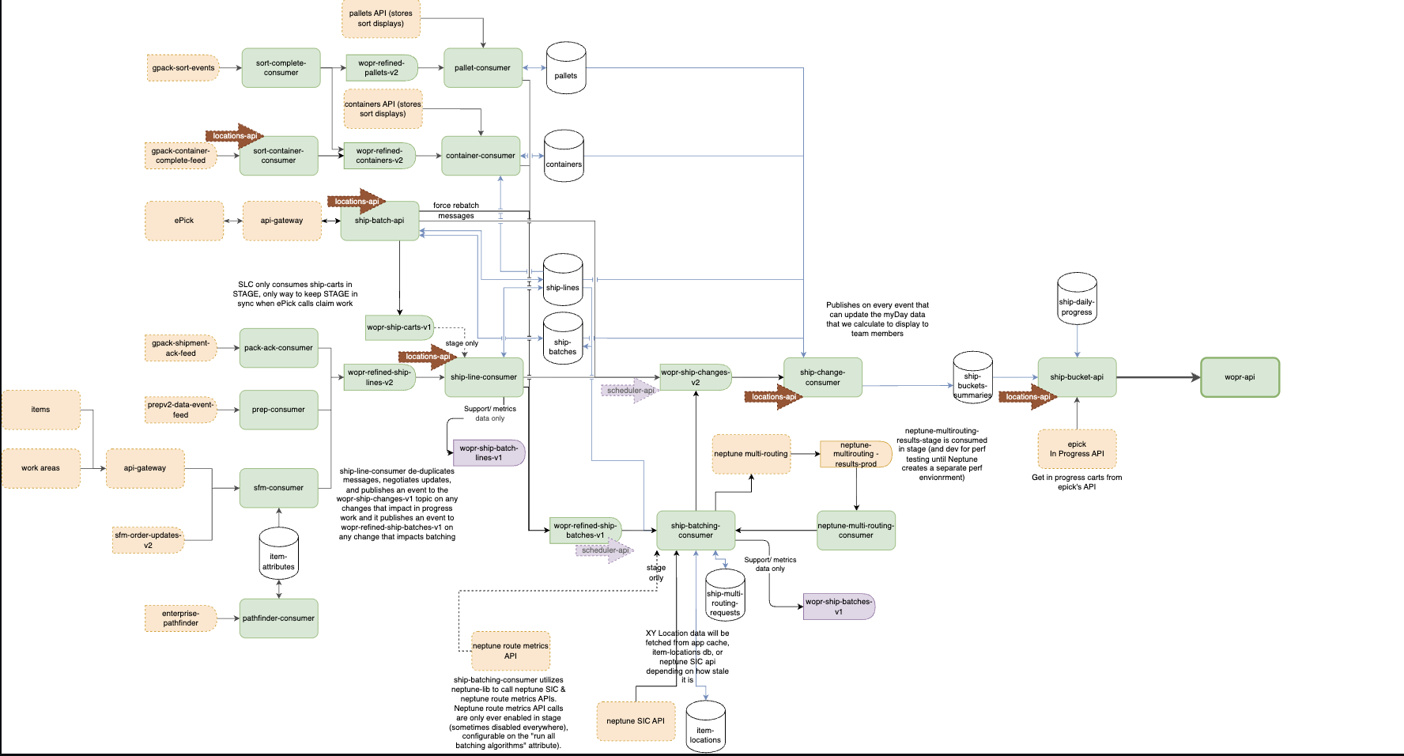
The Problem
Too many repositories to manage
Repeated Gradle/config setup
Harder cross-service changes
CI/CD and dependency overhead

Slide 3
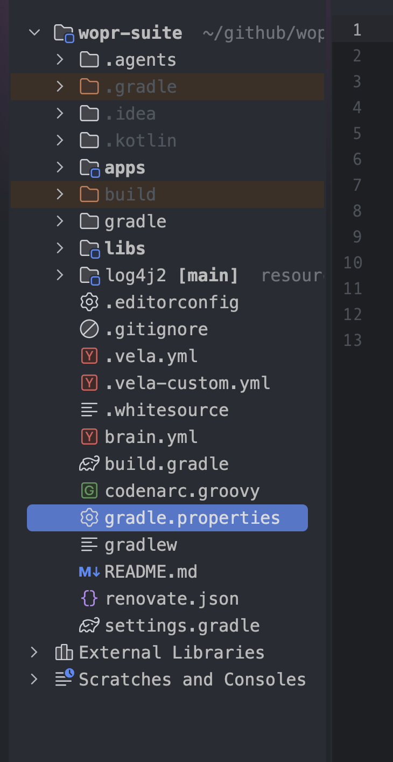
New Repo Structure
Apps(40+) & Libs(20+) grouped under one product repo
Shared libs/configs are now centralized
Clear product boundaries

Slide 4
What Changed Technically
Multi-app Gradle structure
Shared libraries under libs
Common build conventions
Product-level settings/build files

Slide 5
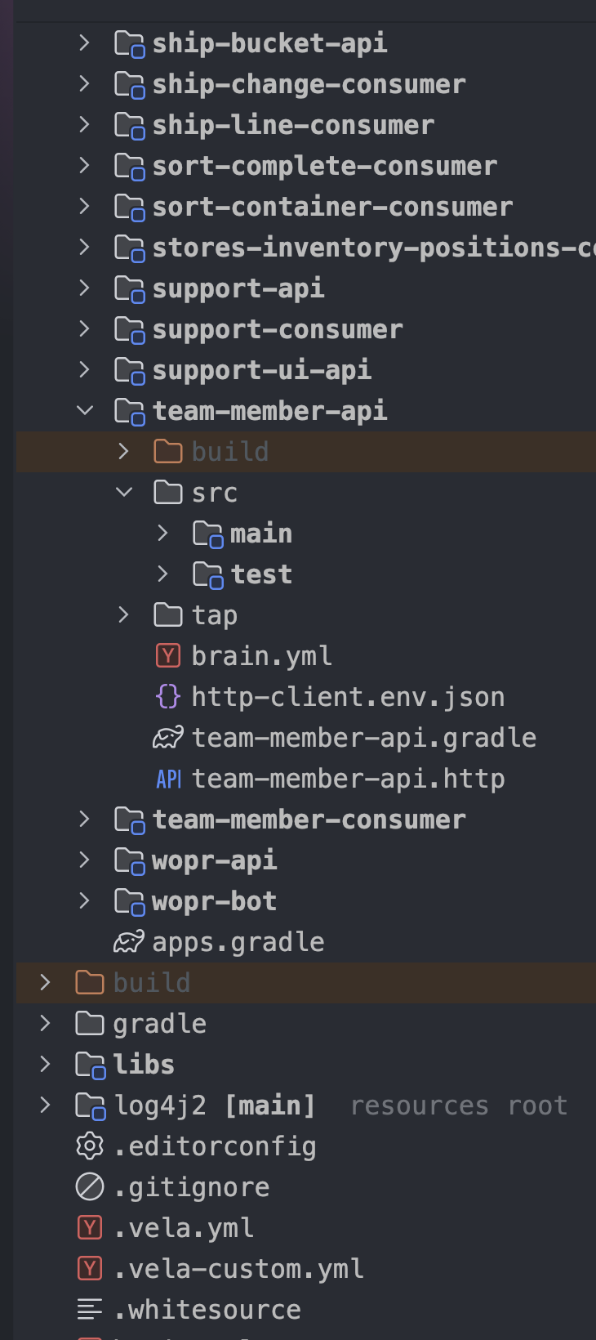
Advantages / Impact
Faster cross-app changes
Less duplicated config
Easier dependency alignment
Better discoverability
Simpler onboarding
Cleaner product ownership

Slide 6
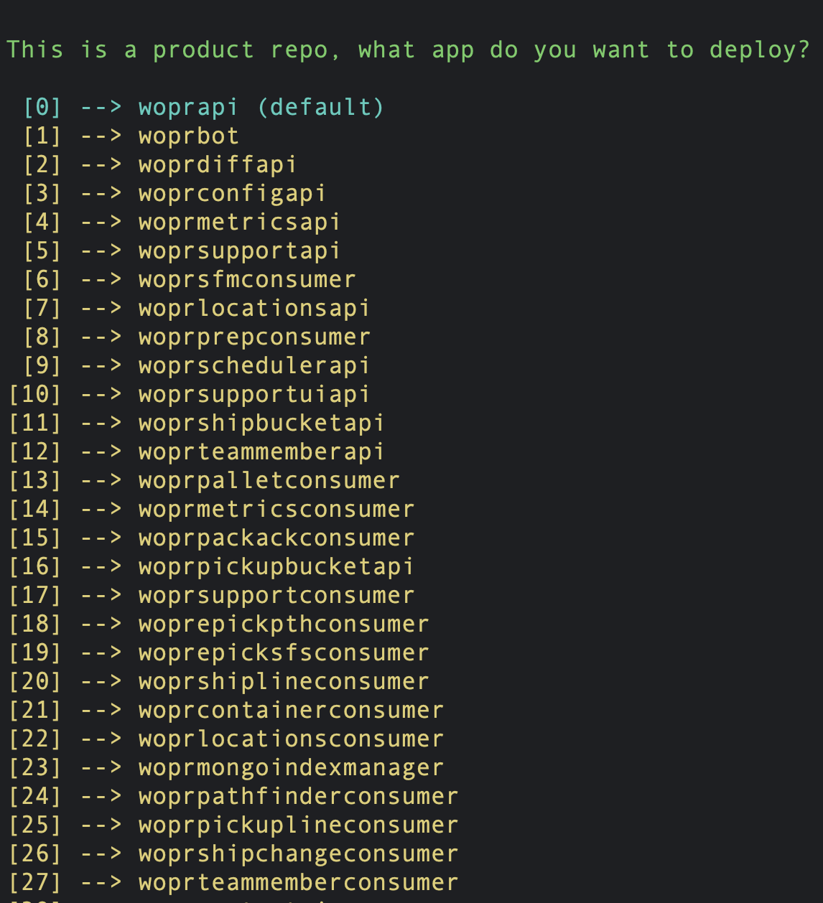
Build Tooling Changes to Support Product Repos
Updated shared command/config tooling to recognize product repo structure
Added support for multiple apps inside one repo
Preserved existing command workflows for developers
Enabled app-specific configuration while sharing common repo-level setup
Reduced manual setup needed when adding or managing apps

Slide 7
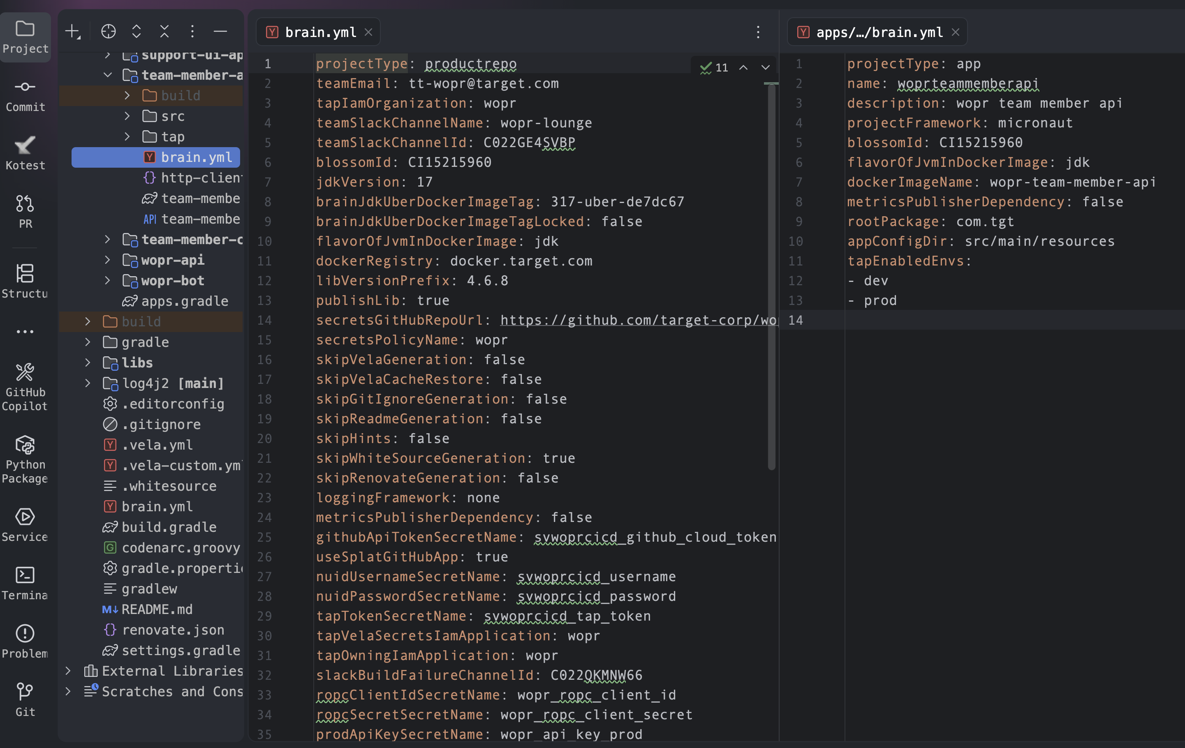

Slide 8
Thank You
Presenter: Abdul Ashwood
Slack: @wopr-lounge
Email: tt-wopr@target.com

